Slide 1

The Complete Nonsense of Edward Lear
Collected and Introduced by Holbrook Jackson
Text Talk
Bonnie Grimes Elementary

Slide 2
Intrinsic- something that is natural or inherent

Slide 3

  Word in context: “There was an Old Man of Peru,
  Who never knew what he should do;
  So he tore off his hair, and behaved like a bear,
  That intrinsic Old Man of Peru.”
Another example: Paola has an intrinsic motivation to do well in school, not because she is getting a reward every day.

Slide 4
Futile- something that won’t succeed

Slide 5
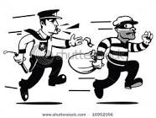
Word in Context: “There was an Old Man who supposed,
That the street door was partially closed;
But some very large rats, ate his coats and his hats,
While that futile old gentleman dozed.
Another example: After a mile or so, the robbers realized that trying to outrun the police was futile.

Slide 6
Murky- dark, gloomy or dirty, or something that is not clear

Slide 7
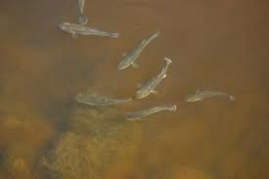
Word in Context: “There was a Young Lady of Turkey,
Who wept when the weather was murky;
When the day turned out fine, she ceased to repine,
That capricious Young Lady of Turkey.
Another example: The pond water was brown and murky.

Slide 8
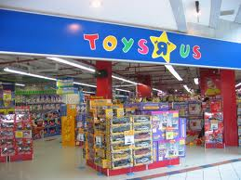

Which picture shows something that is intrinsic to life?
(having a lot of toys or breathing)

Slide 9
When would it be futile to try to find your homework?
If it was lost somewhere in your bedroom
If your dog ate it
If you left it on the bus
If it fell into the ocean and was swept away

Slide 10
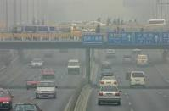
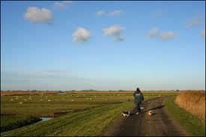
Which picture goes with murky?

